Slide 1
Case Study 1: Beers and Breweries
David Wei, Neil Benson

Slide 2
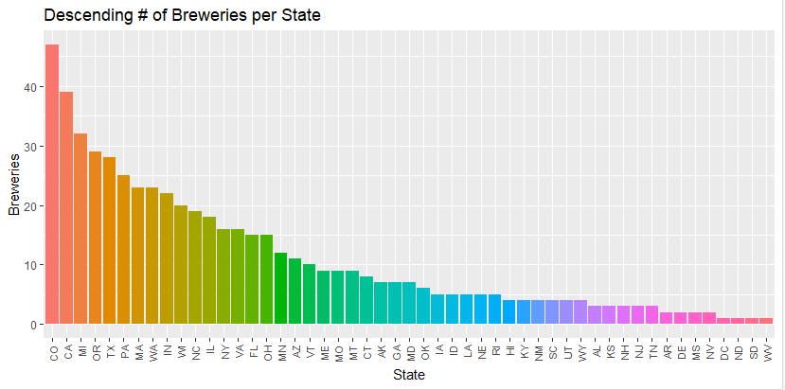
Brewery Statistics per State
Colorado leads in having 47 breweries with three states ND, SD, WV and DC having only 1 each.

Slide 3
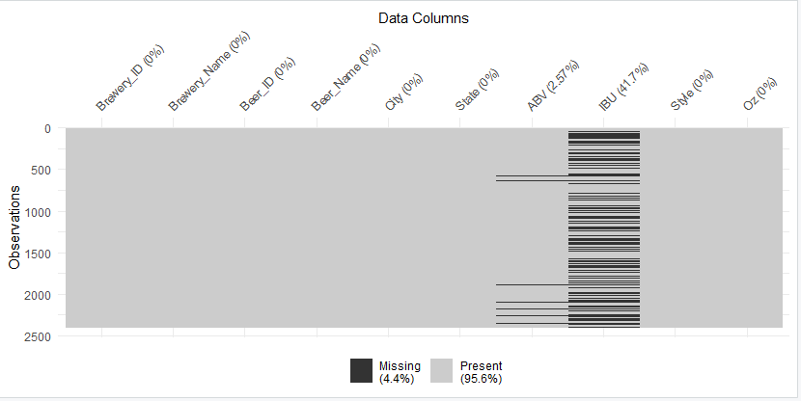
Cleaning the Data
Almost half (~42%) of IBU data was missing, and a little over 2.5% of ABV data was missing.

Slide 4
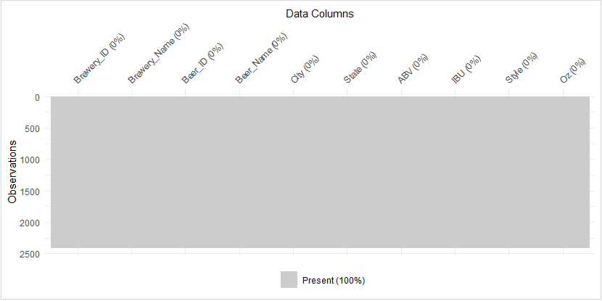
Cleaning the Data
Filled missing values by applying average IBU and ABV per style of beer for greater accuracy.

Slide 5
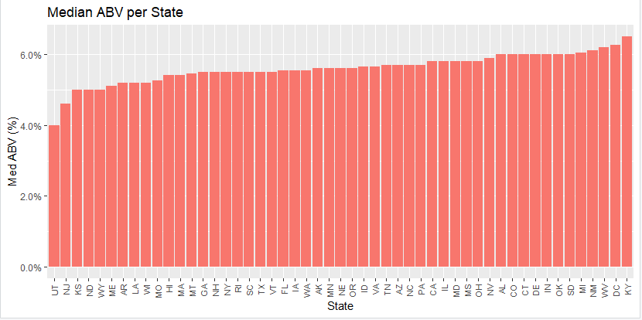
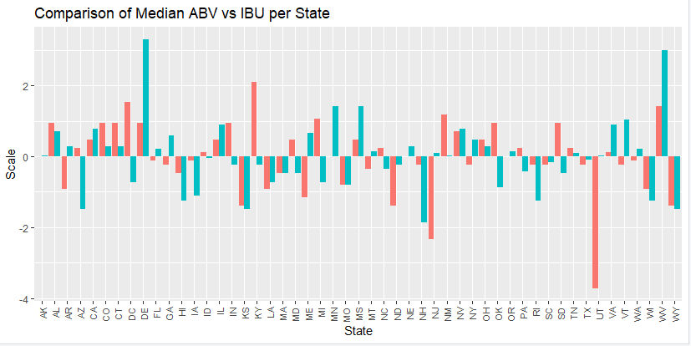
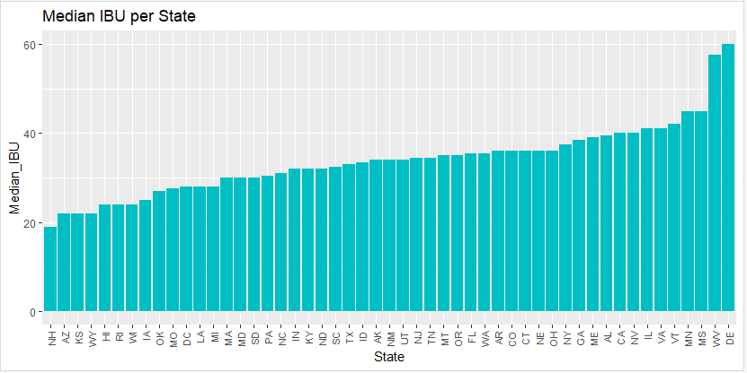
Median ABV and IBU per State
Most beers fell within relative range for median ABV of each other with only a handful of states significantly differing from the rest.

Slide 6
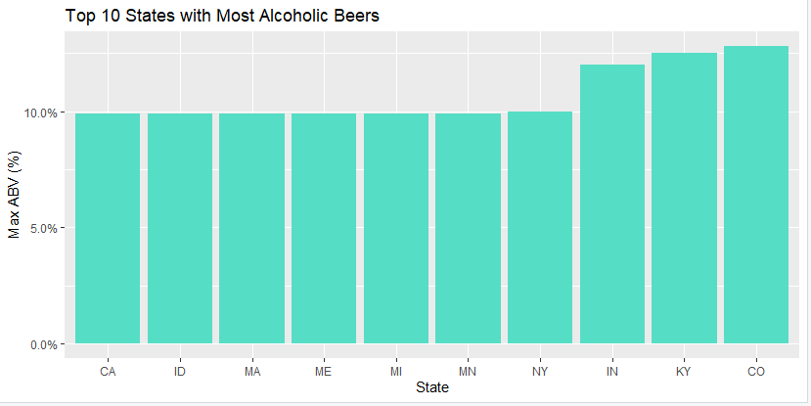
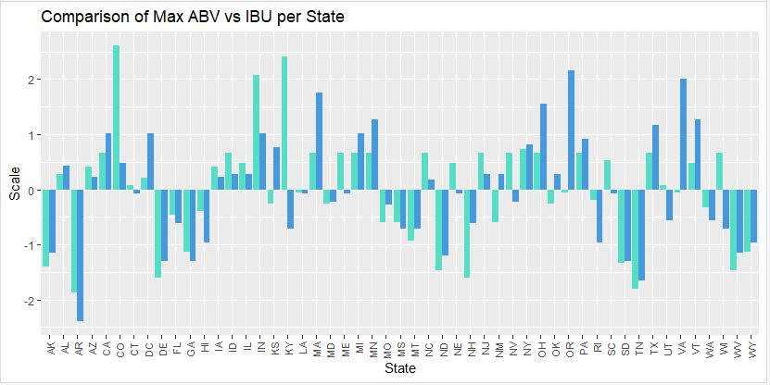
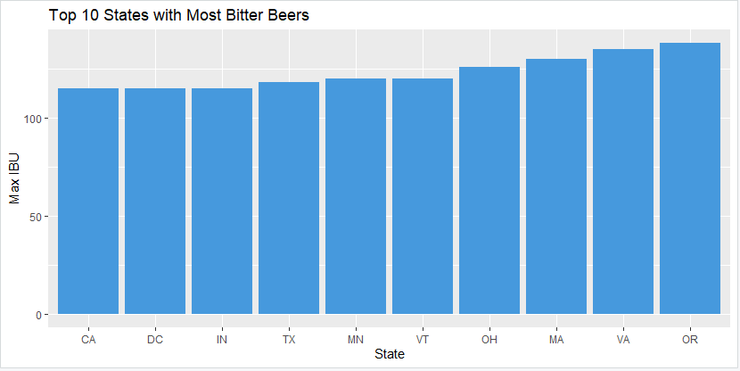
MAX ABV and IBU per State
Colorado has the most alcoholic beers while Oregon had the most bitter. Both of which are in the top 5 for number of breweries and top 6 for breweries per capita, and with Colorado leading in number breweries per state.

Slide 7
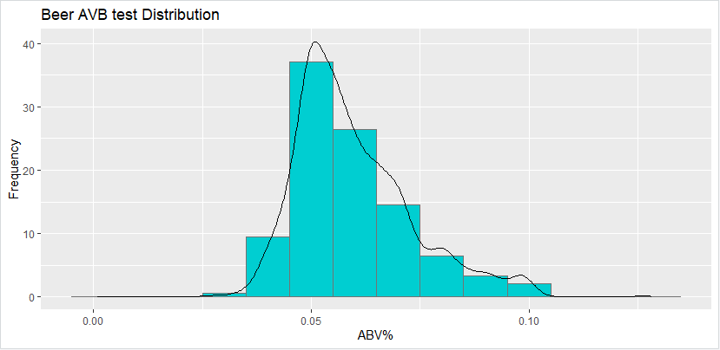
Analysis of ABV
Most of the beers fell within a normal distribution. One thing to note in particular, is the right skew in the distribution with the mean hovering around 5% ABV. This is a reflection of market competition, state laws, and history regarding German purity laws.

Slide 8
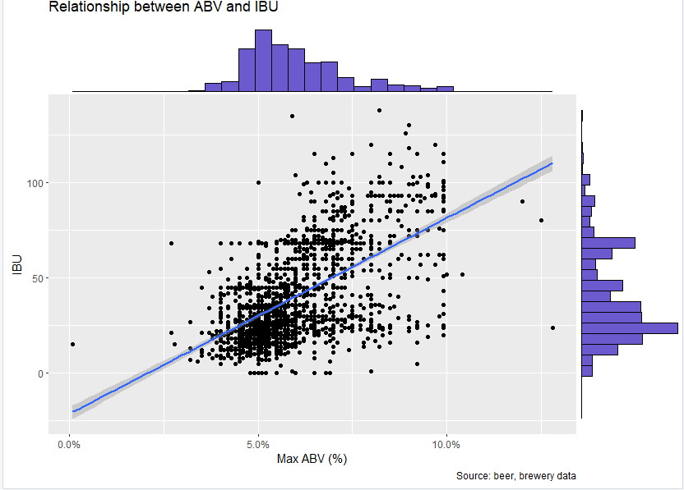
Relationship between IBU and ABV?
IBU
Factors: Bittering compounds
ABV
Factors: Sugar levels during fermentation
Analysis:
Weak to moderate correlation between IBU and ABV, though absence of high IBU beers with low ABV content.
Correlation:
r = 0.57
Estimated that about 32.55% of the variation of a beer’s IBU can be attributed to its ABV.
Future QOI:
ABV vs Sugar?
Corr = 0.57

Slide 9
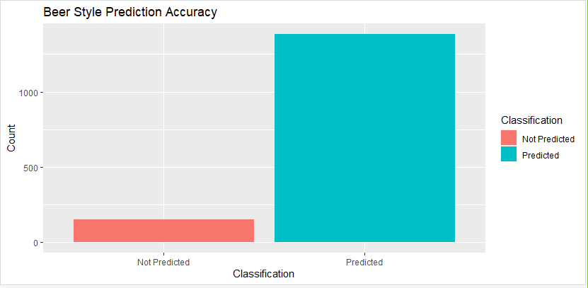
Comparing IPAs vs Ales (knn)
When given an IBUs and ABV only, we can reliably categorize between IPAs and Ales with 90.22% accuracy (with 95% confidence interval between 88.62% and 91.66%). This shows that there is a very strong, statistically significant relationship between IBUs and ABV% for identifying IPAs and Ales.

Slide 10
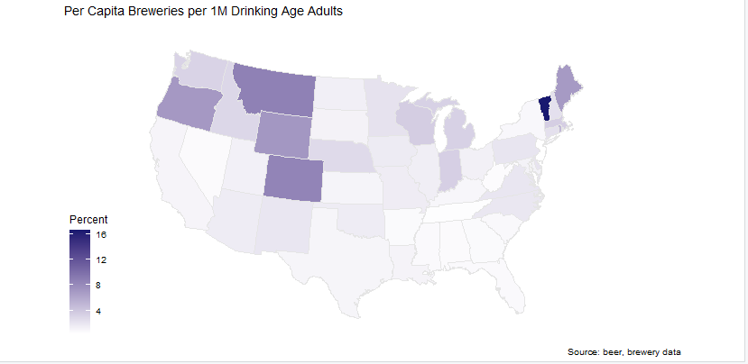
Conclusion
When looking for a place to build a new micro or neighborhood brewery, we can see two advantages:
high population and high per capita breweries
high population and low per capita breweries
For the first option, there will be stiff competition, but a beer thirsty population and often-times considered a beer destination.
With the second option, you could establish a market with little or no competition that could eventually attract both patrons and competition to establish a new beer destination.
pop
per cap
pop
per cap
State | Population | Breweries | Breweries Per Capita | Beers | Beers Per Capita | Median ABV | Max ABV | Median IBU | Max IBU
Colorado | 5,555,200 | 47 | 8.46 | 265 | 47.70 | 0.06 | 0.128 | 36 | 104
Texas | 28,024,000 | 28 | 1.00 | 130 | 4.64 | 0.055 | 0.099 | 33 | 118

Slide 11
Conclusion
Most popular* beer types in CO and TX
State | Most Popular Beers | Count
CO | American IPA | 40
CO | American Pale Ale (APA) | 40
CO | American Amber / Red Ale | 19
TX | American Pale Ale (APA) | 13
TX | American IPA | 12
TX | American Blonde Ale | 10
Least popular* beer types in CO and TX
State | Least Popular Beers | Count
CO | Rye Beer | 3
CO | Schwarzbier | 4
CO | Tripel | 5
TX | Rye Beer | 8
TX | Schwarzbier | 9
TX | Smoked Beer | 10
When exploring beer types in these two markets, we’ve identified both the most popular and least popular by state.
Further analysis needed in order to determine what factors influence their popularity and how they compare to actual production and consumption.
* popularity only determined based on number of beer styles in each market, and is not indexed to include production or consumption metrics.

Slide 12
LINKS
Team Repository – https://github.com/bensonnd/DS6306_David_Neil_Project_1
Neil YouTube Video - https://youtu.be/s5X5uf_ModA

